Slide 1
Bio-Inspired High Speed Pupil-Tracking using a Dynamic Vision Sensor
Joseph Warren, Yufei Wu, Aldo Faisal

Slide 2
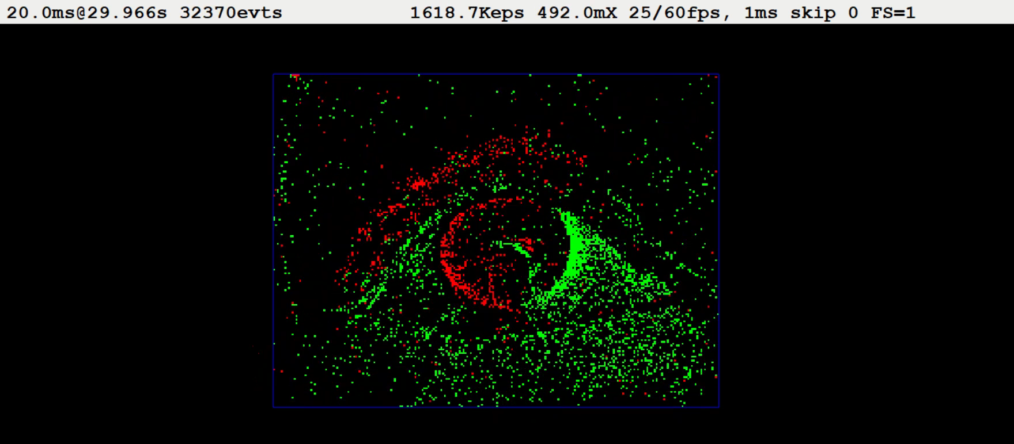
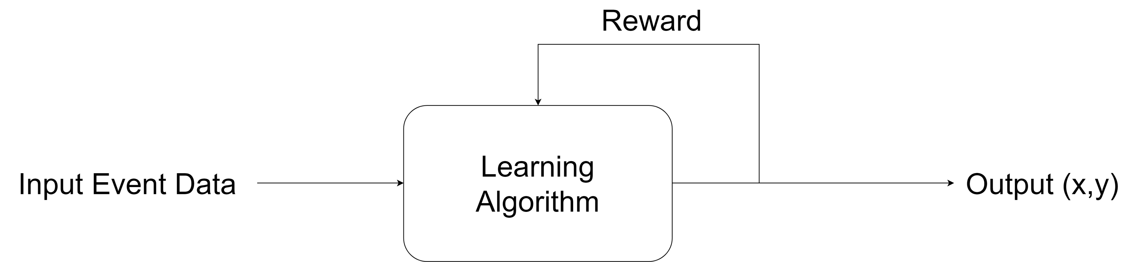
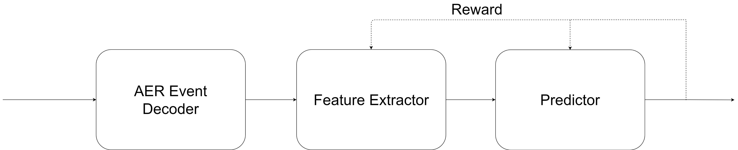
Algorithmic Framework
Pupil Position (x,y)

Slide 3
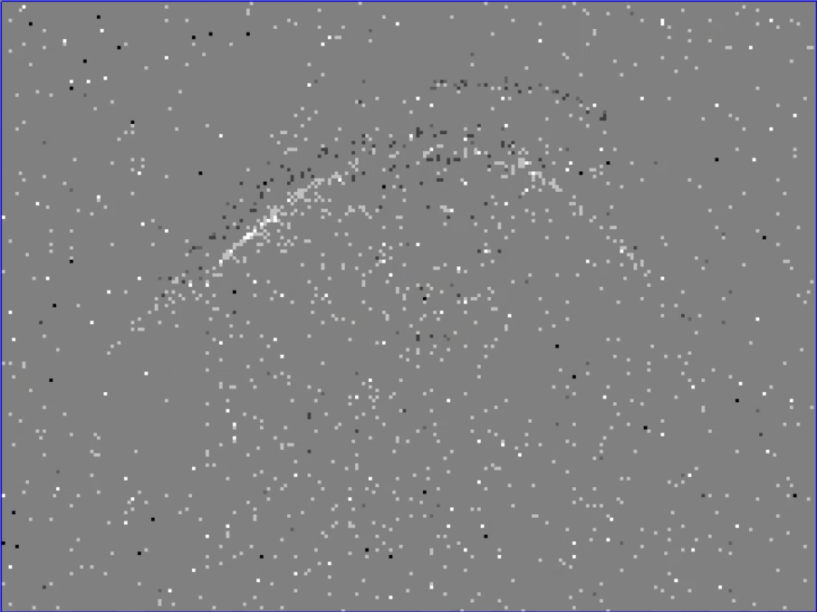
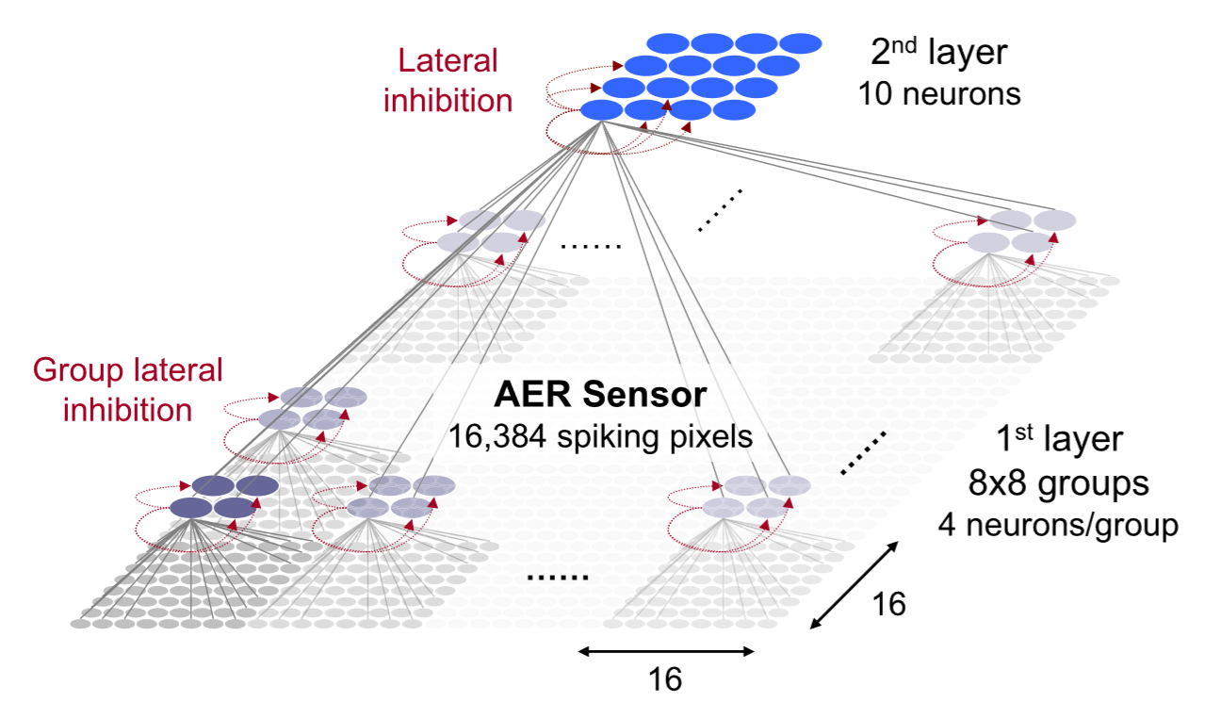
Network Architecture & Data
~40000
5x5 groups
10 neurons/group
5
5

Slide 4
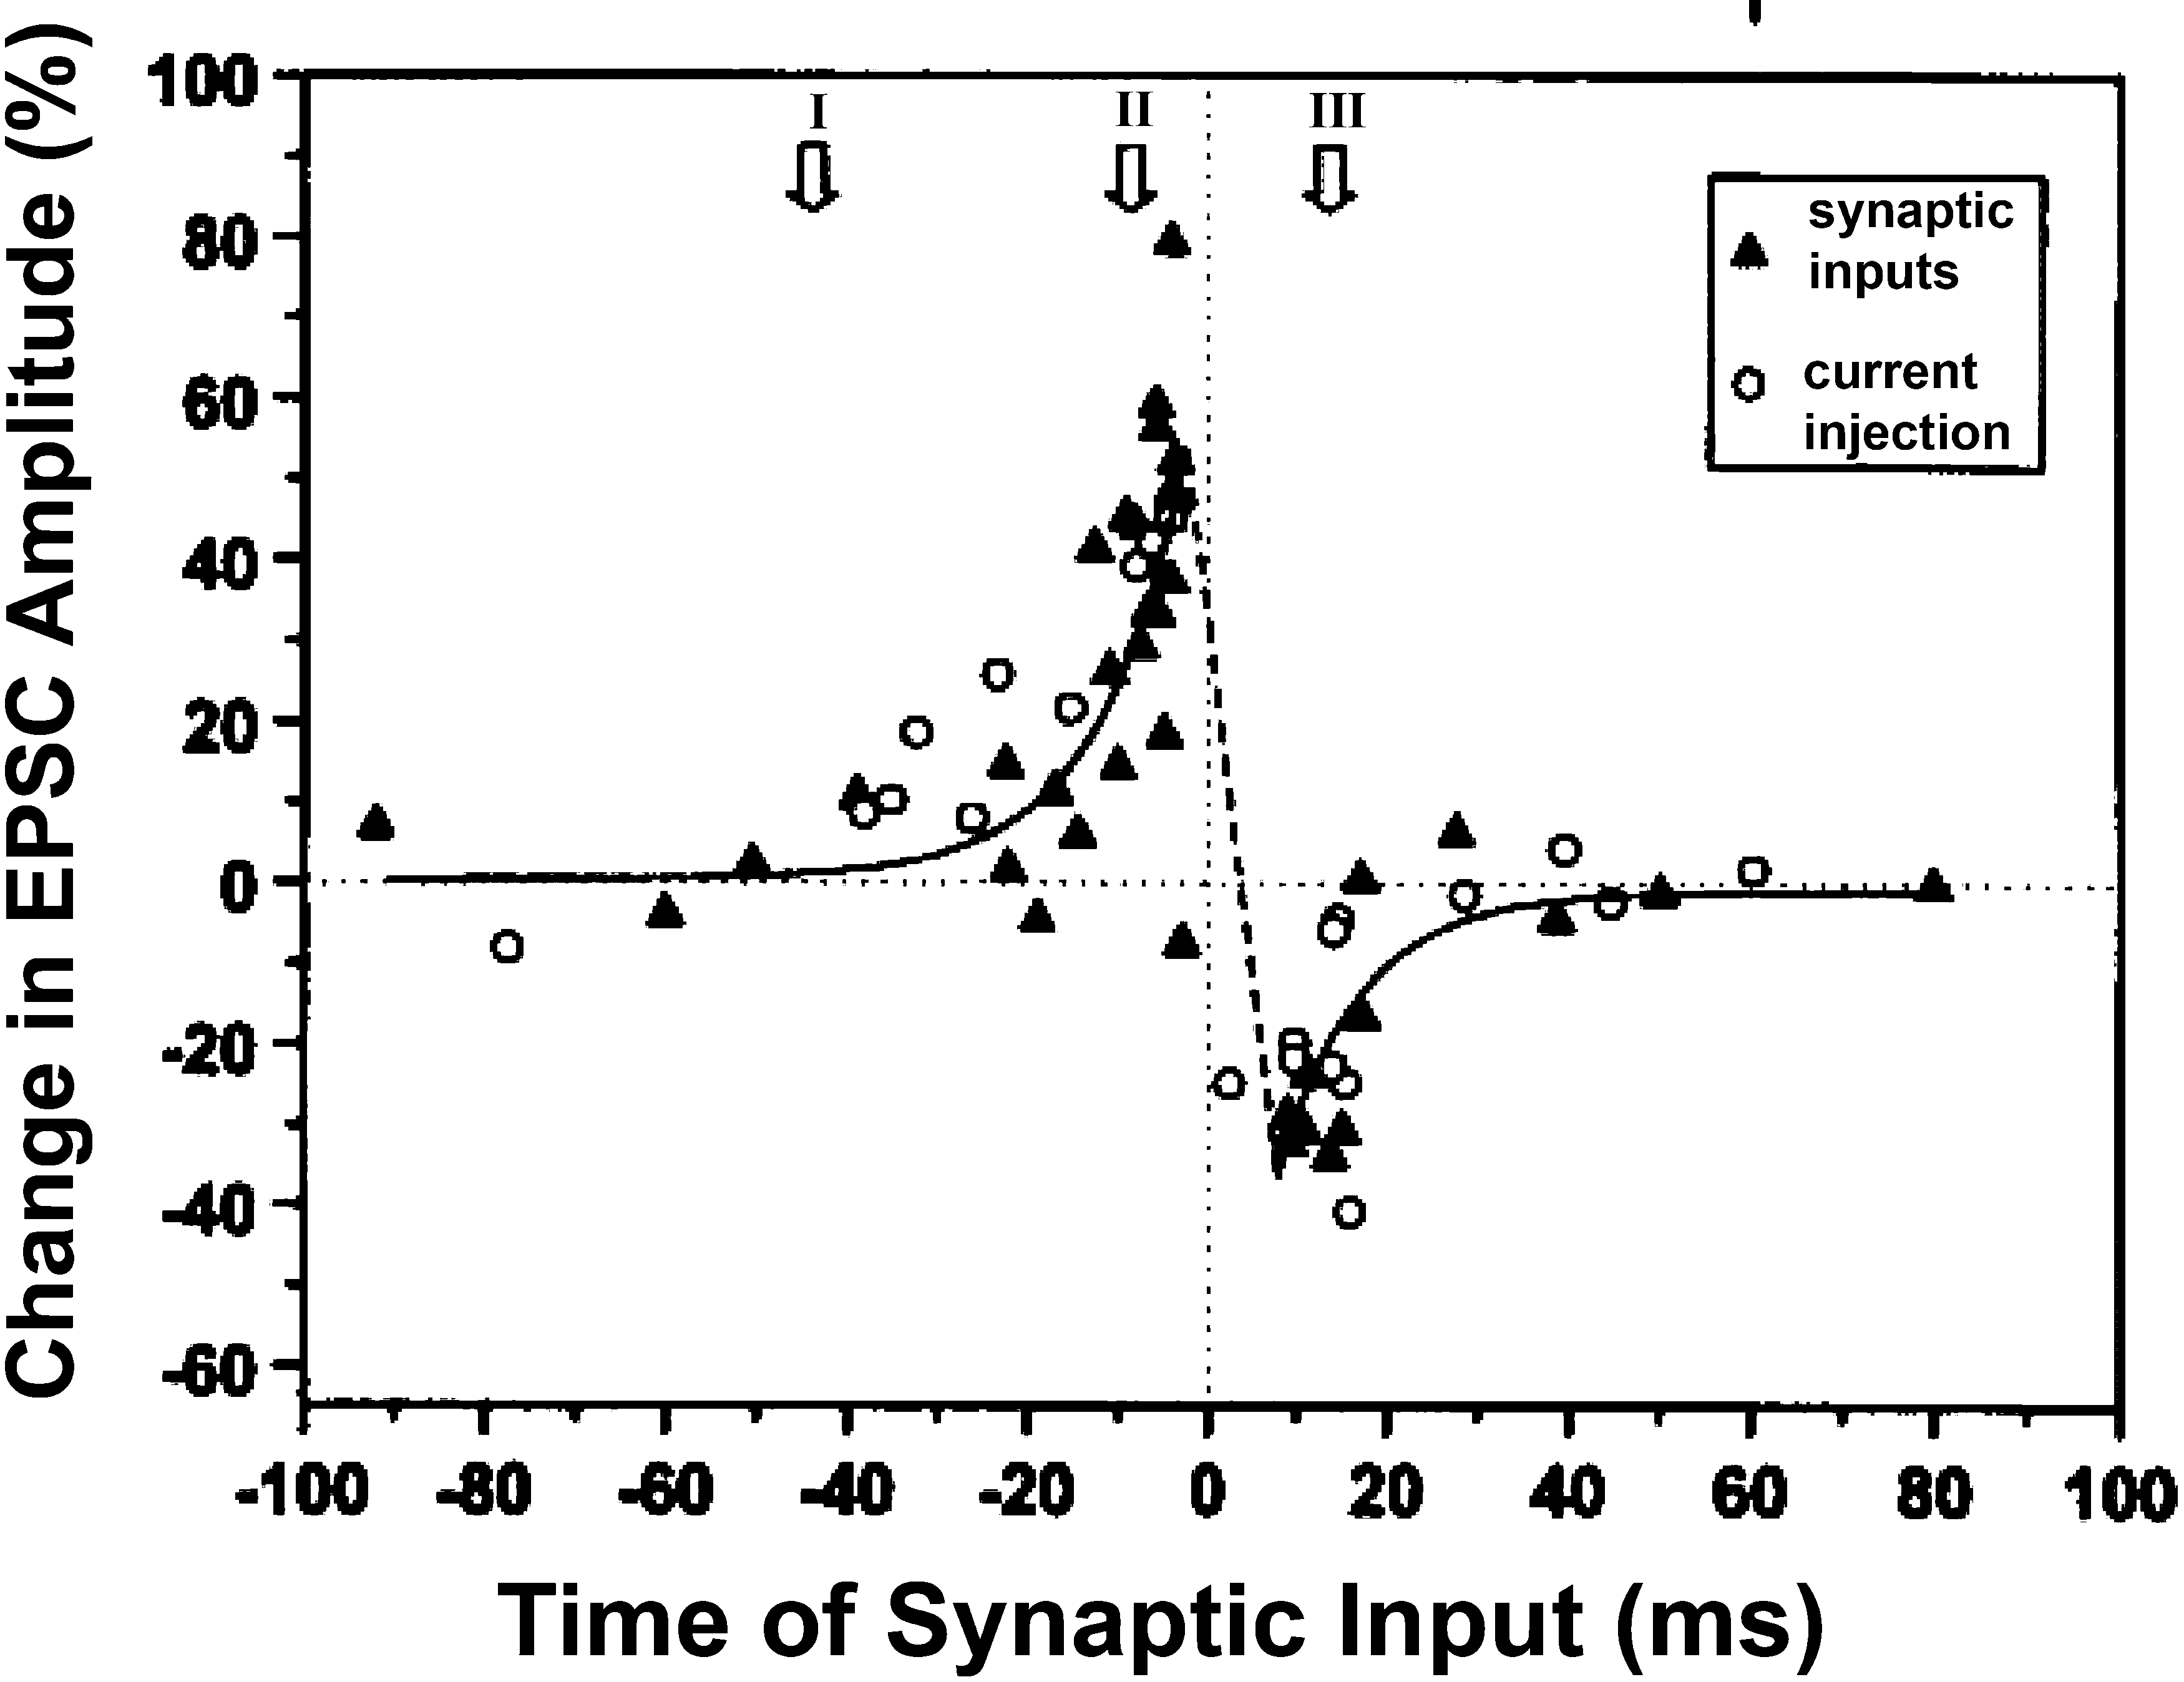
Learning Rules for Feature Extraction
STDP
Creates selectivity to spatio-temporal patterns
Lateral Inhibition
Leads to competition between neurons
Dan Y, Poo MM. Spike timing-dependent plasticity of neural circuits. Neuron. 2004; 30;44(1):23-30

Slide 5


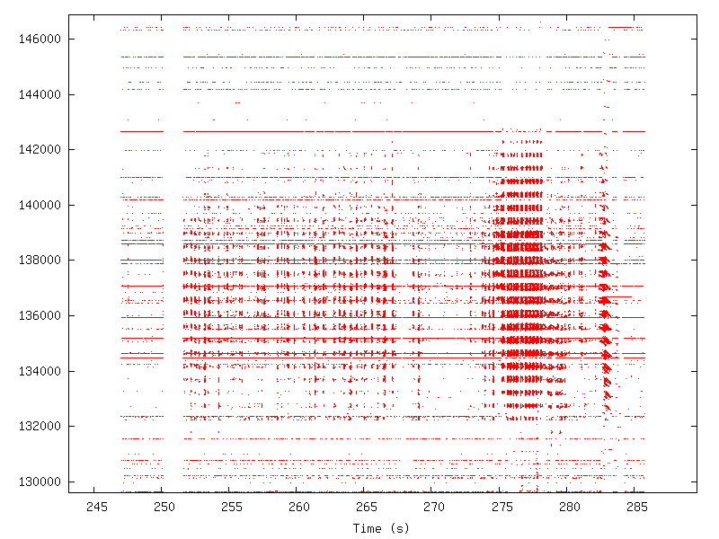








Results
Receptive Fields for 10 neurons covering 5x5 patch
Neuron ID

Slide 6




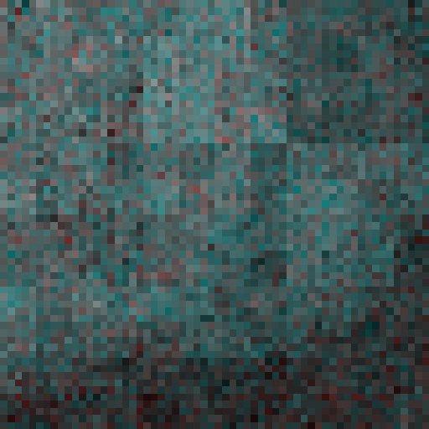
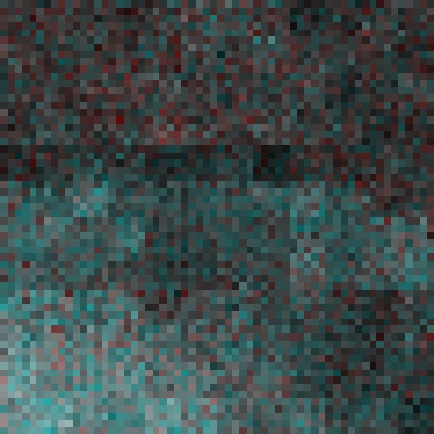


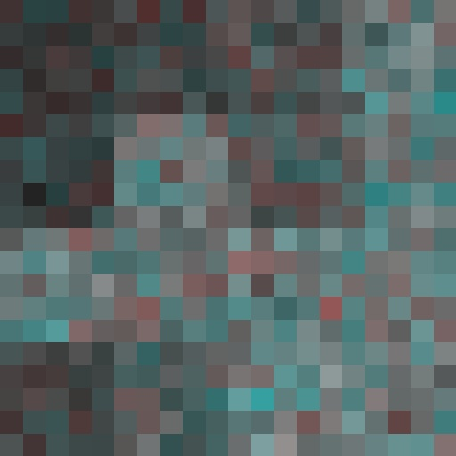

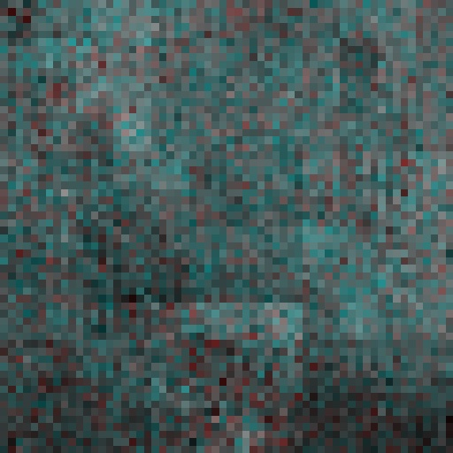
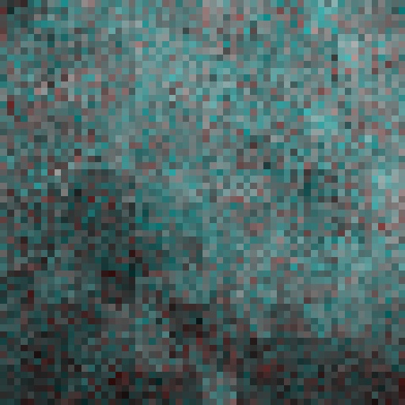
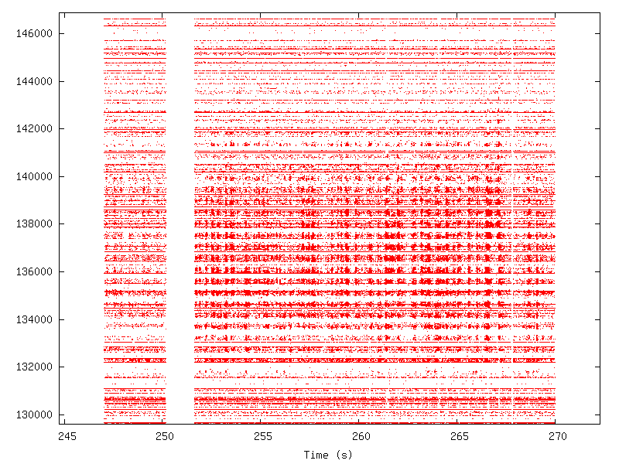
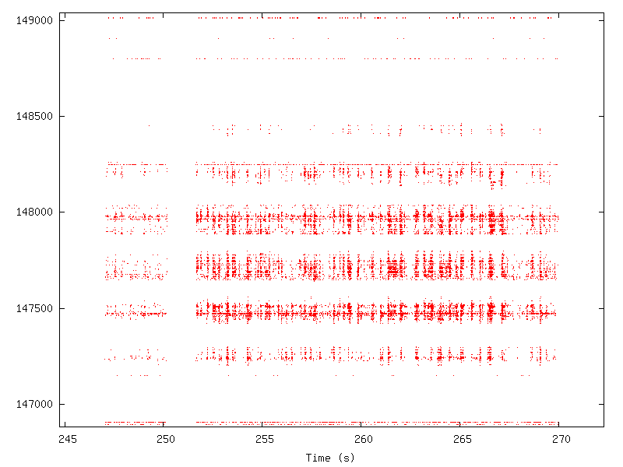
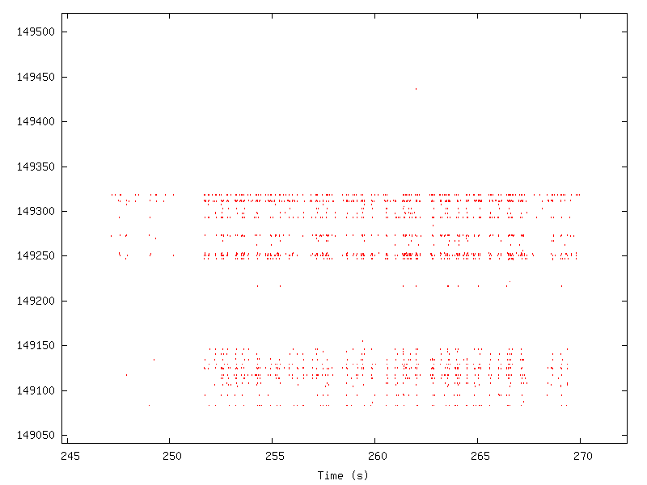
(Bad) Feature Extraction at Higher Layers…
Layer 2 (4x4)
Layer 3 (3x3)
Layer 1 (5x5)
Problem: learning is happening at higher levels, but learning from poor features…

Slide 7
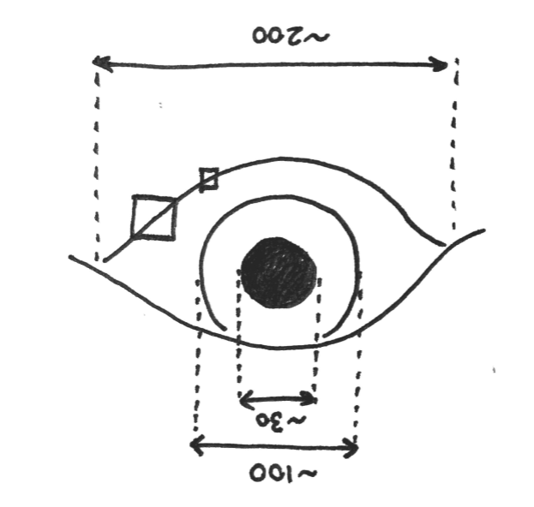
Solution: Fix bottom layer
Bottom layer is not extracting good features
Limits ability of higher layers
Enlarge Receptive Fields of neurons
5x5 to 16x16
Features not present at lower scales
Initialise receptive fields of neurons prior to learning
How to find ideal receptive fields to initialise with?
Sparse coding

Slide 8
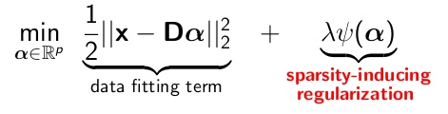
Sparse Coding
Finds ‘dictionary’ of features that best represent data
Features are such that each data sample is a sparse combination of features in dictionary
i.e. want to use few features per sample
This can be used to find receptive fields!
Has been used for natural images
Need to repeat for DVS data (i.e. event data)

Slide 9
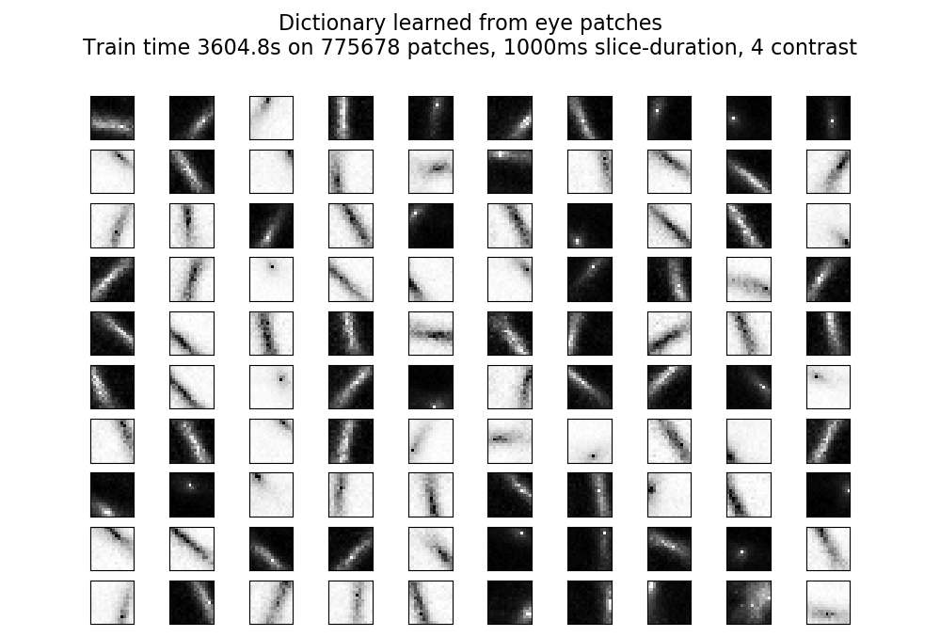
Sparse Coding results from DVS data
Strong orientation selectivity
In agreement with receptive fields of visual cortex
Conclusion: initialise neurons as orientation-selective
Each neuron has preferred angle

Slide 10
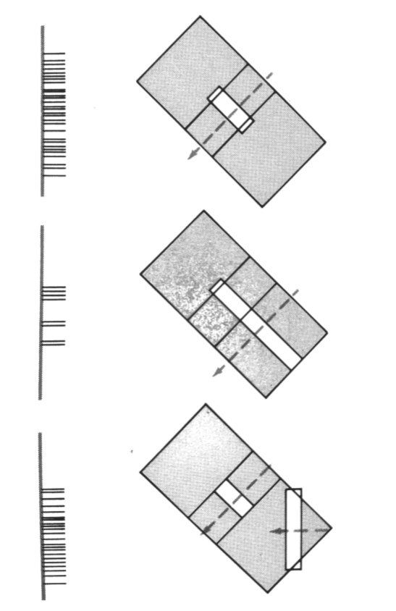
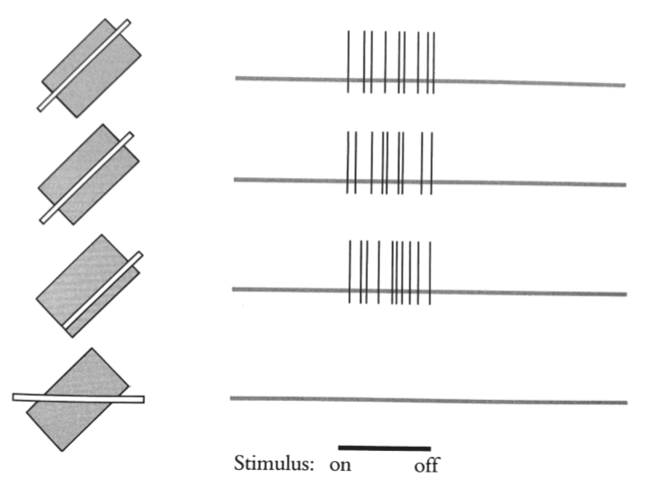
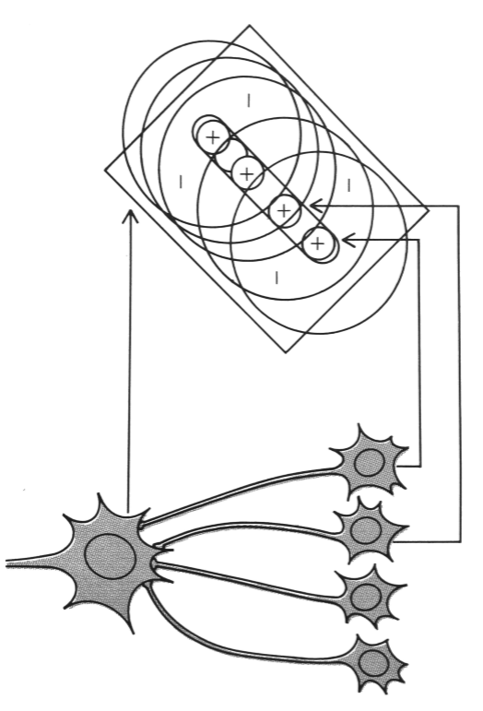
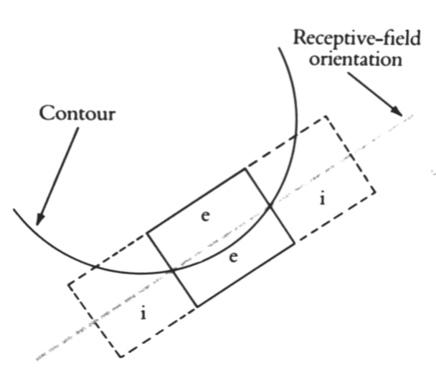
Detour to Biology
Orientation-selective cells
End-capped orientation-selective cells
Hubel, D. (1988). Eye, Brain, and Vision. 1st ed. New York: Scientific American Library.

Slide 11





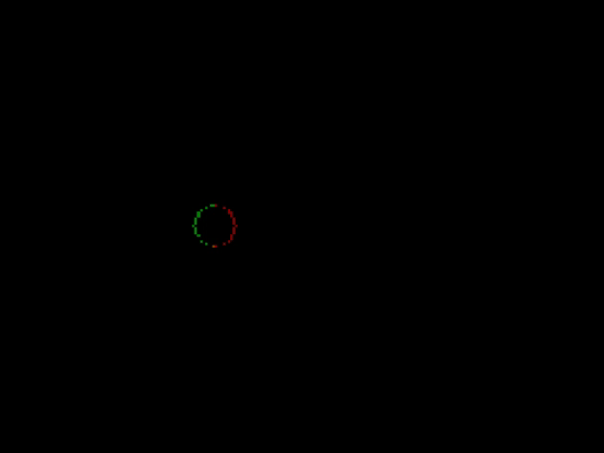
Final Solution
Preferred radius of curvature:
Inf (straight)
10 pixels
0º
Going to initialise first layer weights
Incorporate two categories
Orientation-selective
End-capped orientation-selective
Test selectivity
Made synthetic data:
Moving bar
Moving circle of variable radius
Preferred Angle:
45º

Slide 12
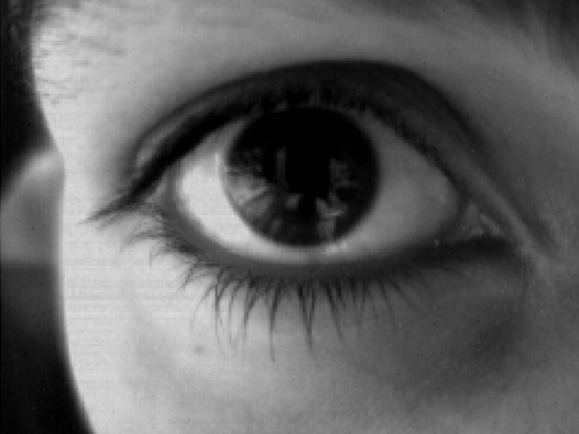
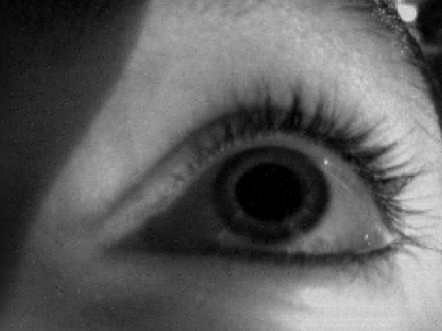
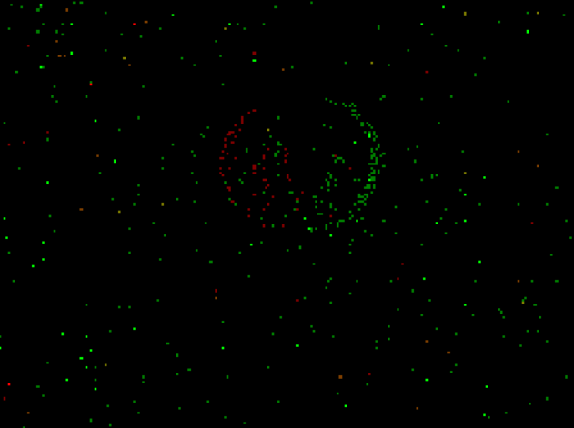
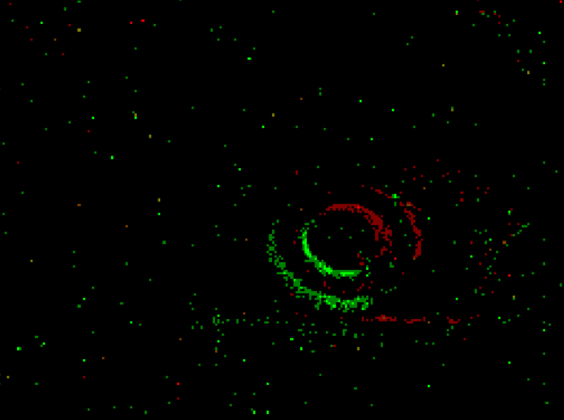
Data collection
Installed IR light source
Shows pupil better
Below safe limit (10mW/cm²)
For each frame we need pupil position (x,y) for reward
Use standard pupil detector/hand labelling
Protocol for training data
Even distribution of pupil positions?
Random eye movement?
Different sittings
Test data
Random (natural) eye movement
Different time of day?
Different eye-position?
Different user?

Slide 13
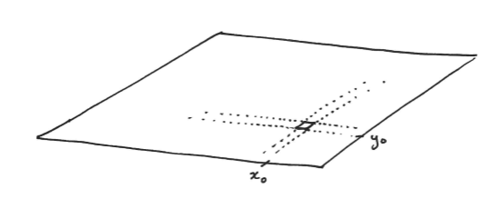
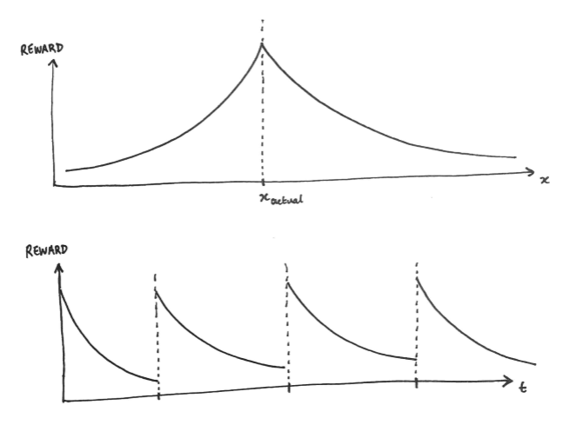
Reward Layer
Population code
Effectively classification
Each neuron corresponds to pupil position
(x,y) in pixels
Reward conveyed via synaptic potentiation or depression
Don’t want one-hot classification
Some wrong predictions are better than others
Need to deal with asynchrony between reward time and prediction time

Slide 14
Plan for next month
After 1-1.5 weeks
Feature extractor finished
Tested with synthetic data, selectivity proven
Data collected and labelled
After 2.5-3 weeks
Reward layer working
Accuracy & latency measured
After 4 weeks
High-speed performance verified on lab computer
Report

